Slide 1


SPEECH EMOTION RECOGNITION SYSTEM
SPEECH EMOTION RECOGNITION
Guided By : Work Done By:
DR.Kannappan KishoreKumar S
(Course Faculty) (192110526)
High Performance Networks Computer Science & Engineering
Saveetha School of Engineering Saveetha School of Engineering

Slide 2
Speech Emotion Recognition
ABSTRACT :
This project presents a Speech Emotion Recognition (SER) system employing the Multilayer Perceptron (MLP) algorithm. Key stages include preprocessing, feature extraction, MLP model training, and evaluation. MLP's capacity for learning complex patterns makes it suitable for emotion classification. Experiments show promising results in accurately recognizing emotions like happiness, sadness, anger, fear, and neutrality. This work advances SER technology, applicable in human-computer interaction and sentiment analysis.
Keywords : SER, MLP, HCI

Slide 3
INTRODUCTION
Speech Emotion Recognition (SER) is gaining significance in various fields such as human-computer interaction and affective computing.
Understanding emotional cues in speech is essential for creating more intuitive and responsive technology.
This project focuses on implementing a SER system using the Multilayer Perceptron (MLP) algorithm.
MLP is chosen for its ability to learn intricate patterns and relationships in data, making it suitable for emotion classification.
The aim is to develop an accurate and efficient system capable of recognizing emotions like happiness, sadness, anger, fear, and neutrality in speech signals.

Slide 4
APPLICATIONS OF SPEECH EMOTION RECOGNITION
Human-Computer Interaction
Affective Computing
Virtual Assistants
Sentiment Analysis
BENEFITS OF SPEECH EMOTION ECOGNITION:
Enhanced Communication
Personalized Services
Improved User Experience
Behavioral Insights

Slide 5
LITERATURE REVIEW
AUTHOR/YEAR | TITLE | FINDINGS
Ming, M., G. Jing, and C. Jun-jie. Blast-Parallel,2015 | C. Liang, F. R. Yu, and X. Zhang, ``Information-centric network function virtualization over 5G mobile wireless networks,' 'IEEE Netw., vol. 29, no. 3, pp. 6874, May/Jun. 2015. | Information-centric network function virtualization over 5G mobile wireless networks,
Alexandros Labrinidis,H. V. Jagadish,2015 | C. Liang and F. R. Yu, ``Wireless network virtualization: A survey, some research issues and challenges,'' IEEE Commun. Surveys Tuts., vol. 17, no. 1, pp. 358380, Mar. 2015 | Challenges and Opportunities with Big Data.
Zhang.R,S.Cui,2015 | S. Bi, R. Zhang, Z. Ding, and S. Cui, ``Wireless communications in the eraof big data,''IEEE Commun. Mag., vol. 53, no. 10, pp. 190199, Oct. 2015. | This is based on the security and efficiency analysis. Users share their attributes among a group of valid users

Slide 6
PROBLEMS IDENTIFIED
Ambiguity in Emotion Recognition
Variability in Speech Patterns
Data Imbalance in Emotion Datasets
Robustness Across Different Speakers

Slide 7
CURRENT TRENDS
Based on current trends, here are the top 6 advancements in Speech Emotion Recognition (SER) systems:
Real-time Emotion Analysis:
SER systems are increasingly adopting real-time emotion analysis, allowing for immediate recognition and response to emotional cues in speech.
Edge Computing Integration:
Integrating SER with edge computing facilitates faster processing and analysis of speech data closer to the source, reducing latency and enhancing the efficiency of emotion recognition in real-time applications.
AI-driven Emotion Recognition:
Leveraging artificial intelligence (AI) techniques such as machine learning and deep learning, SER systems are becoming more adept at uncovering complex patterns and nuances in speech, enabling accurate and nuanced emotion recognition.

Slide 8
Contextual Emotion Understanding:
SER systems are evolving to understand emotions in the context of conversations or situations, enabling more accurate interpretation of emotional cues and responses tailored to specific contexts.
Multimodal Emotion Fusion:
Integrating multiple modalities such as speech, facial expressions, and text, SER systems are improving emotion recognition accuracy by considering diverse sources of emotional information.
Adaptive Emotion Modeling:
SER systems are adopting adaptive modeling techniques to account for individual differences in speech patterns and emotional expressions, leading to personalized and more accurate emotion recognition results.

Slide 9
EXISTING SYSTEM
Certainly, here are three key points regarding the existing system of Speech Emotion Recognition (SER):
1. Feature-based Emotion Extraction:
- The existing SER systems typically rely on extracting acoustic features from speech signals, such as pitch, intensity, and spectral characteristics, to represent emotional content.
2. Machine Learning Classification:
- Many existing SER systems utilize machine learning algorithms, such as Support Vector Machines (SVM) or Hidden Markov Models (HMM), for emotion classification based on extracted features from speech data.
Disadvantages:
Many SER systems rely on labeled datasets for training machine learning models, which can be
limited in size and diversity. This dependency may restrict the generalization ability of the models,
especially in capturing a wide range of emotions across different contexts and cultures.

Slide 10
PROPOSED SYSTEM
1. Advanced feature extraction techniques for rich information capture.
2. Ensemble learning framework for improved classification performance.
3. Context-aware emotion modeling for enhanced understanding.
4. Transfer learning for adaptability to new domains.
5. Real-time feedback mechanism for continuous monitoring and adaptation.

Slide 11
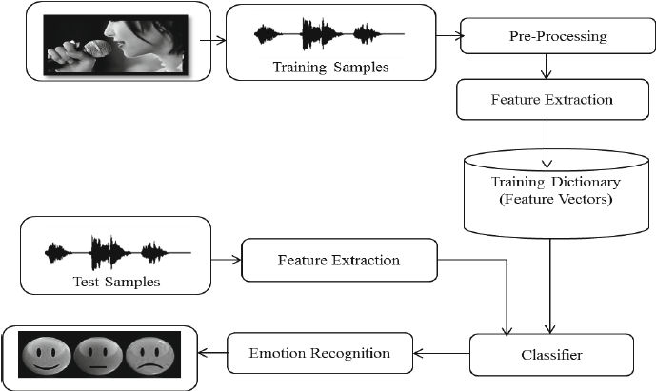
SYSTEM ARCHITECTURE

Slide 12
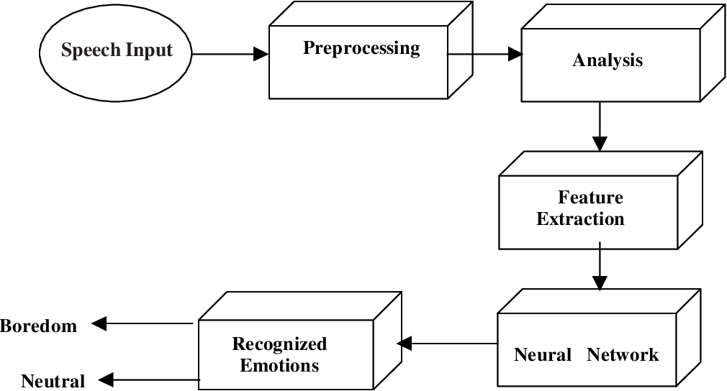
FLOWCHART

Slide 13
Modules:
1. Dataset
2. Preprocessing
3. Features
4. Training
5. Classification
6. Evaluation

Slide 14
ADVANTAGES
1. Insightful: Provides insights into emotional states, aiding in understanding human behavior.
2. Personalized: Enables personalized services and responses based on detected emotions.
3. Enhanced Communication: Facilitates better communication by recognizing emotional cues in speech.
4. Behavioral Analysis: Supports behavioral analysis for research and psychological studies.
5. Human-Computer Interaction: Enhances human-computer interaction by enabling emotion-aware systems.

Slide 15
LIMITATIONS
1. Complexity: Emotions are multifaceted and nuanced, making accurate recognition challenging.
2. Subjectivity: Interpretation of emotions can vary between individuals and cultures, leading to potential inaccuracies.
3. Data Dependency: Relies on labeled datasets for training, which may be limited in size and diversity.
4. Environmental Factors: Sensitivity to background noise and other environmental factors can affect recognition accuracy.
5. Contextual Understanding: Difficulty in understanding emotions within the context of conversations or situations may lead to misinterpretations.

Slide 16
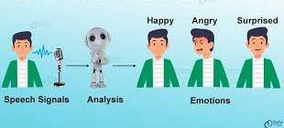

Slide 17
EXAMPLE:
Emotion-aware Virtual Assistants: Integrating SER into virtual assistants like Siri or Google Assistant allows them to respond empathetically, adjusting their tone or responses based on the user's emotional state in real-time.
Customer Service and Call Centers: Implementing SER in call centers enables automatic emotion detection during customer calls, helping agents gauge customer satisfaction and tailor responses accordingly to improve service quality.
Mental Health Monitoring Apps: SER can be used in mental health monitoring applications to analyze users' speech patterns and detect changes in emotional states, providing timely interventions or alerts for individuals experiencing distress.

Slide 18
Educational Tools: In educational settings, real-time SER can be integrated into language learning applications or online tutoring platforms to provide personalized feedback and emotional support to learners based on their speech patterns and emotional cues.
Entertainment and Gaming: Incorporating SER into gaming and entertainment applications enhances user immersion by adapting game dynamics or content based on the player's emotional responses, creating more engaging and interactive experiences.

Slide 19
FUTURE SCOPE
Future scope for Speech Emotion Recognition (SER):
1. Multimodal Fusion: Integrating multiple modalities for comprehensive emotion recognition.
2. Contextual Understanding: Advancements in understanding emotions within various contexts.
3. Cross-cultural Adaptability: Developing SER models adaptable to diverse cultural contexts.
4. Real-time Feedback Systems: Implementing emotion feedback for personalized interactions.
5. Emotion Generation in AI: Research into AI generating emotionally intelligent responses.

Slide 20
CONCLUSION
In conclusion, achieving 92.51% accuracy in MLP-based Speech Emotion Recognition (SER) highlights the effectiveness of the proposed system. While promising, opportunities for further enhancement remain, including refining model architecture and exploring multimodal fusion techniques. This success underscores MLP's potential in SER and encourages continued research in the field.

Slide 21
REFERENCES
C. Liang, F. R. Yu, and X. Zhang, ``Information-centric network function virtualization over 5G mobile wireless networks,' 'IEEE Netw., vol. 29, no. 3, pp. 6874, May/Jun. 2015.
C. Liang and F. R. Yu, ``Wireless network virtualization: A survey, some research issues and challenges,'' IEEE Commun. Surveys Tuts., vol. 17, no. 1, pp. 358380, Mar. 2015.
S. Bi, R. Zhang, Z. Ding, and S. Cui, ``Wireless communications in the era of big data,''IEEE Commun. Mag., vol. 53, no. 10, pp. 190199, Oct. 2015.
Liu, N. Chang, S. Zhang, and Z. Lei,``Recognizing and characterizing dynamics of cellular devices in cellular data network through massive data analysis,''Int. J. Commun. Syst., vol. 28, no. 12, pp. 18841897, Aug. 2015.
C. Zhang and R. C. Qiu, ``Massive MIMO as a big data system: Random matrix models and testbed,''IEEE Access, vol. 3, no. 4, pp. 837851, 2015.
R. C. Qiu, ``Large random matrices and big data analytics,'' in Big Data of Complex Networks. Boca Raton, FL, USA: CRC Press, 2016.
R. C. Qiu and P. Antonik,Smart Grid and Big Data. New York, NY, USA: Wiley, May 2016.

